Slide 1
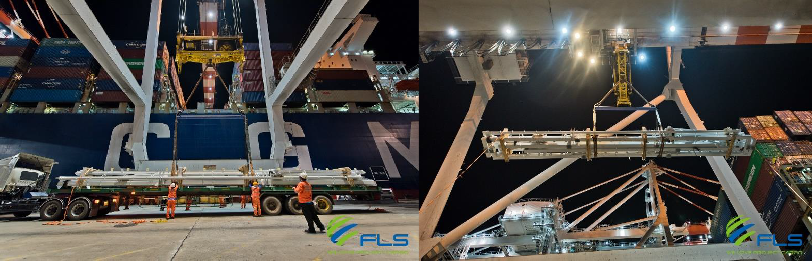
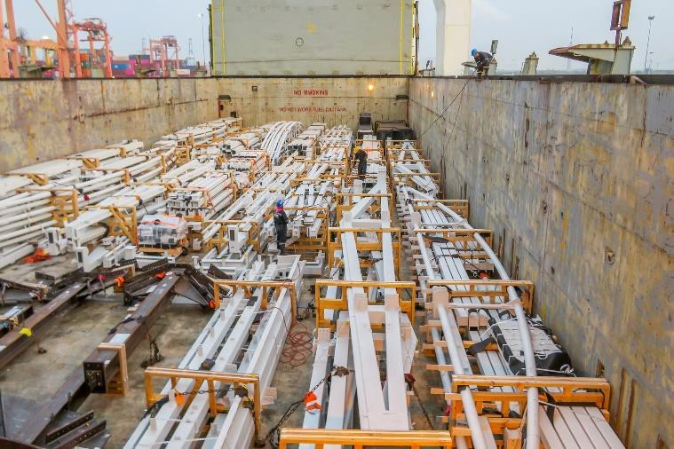
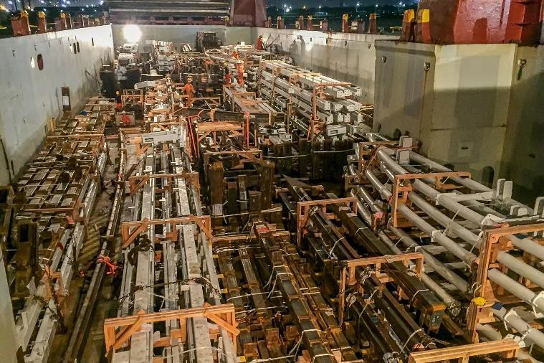
PROJECT REFERENCES
CASE STUDY – Lased roof steel structures
Project Name:
Project Owner:
Volume:
Commodity:
Origin:
Destination:
Lucas Arts Museum
Thai Herrick
10,000 cbm, Max. GW 20 MT
Various steel structures
Thailand
Los Angeles, USA
Scope:
Pre-Carriage EXW to Laem Chabang port
Re-loading and FAS delivery at Laem Chabang port
Loading and securing onto break bulk vessel
Break bulk ocean freight from Laem Chabang port to port of Los Angeles
On-carriage to site

