Slide 1
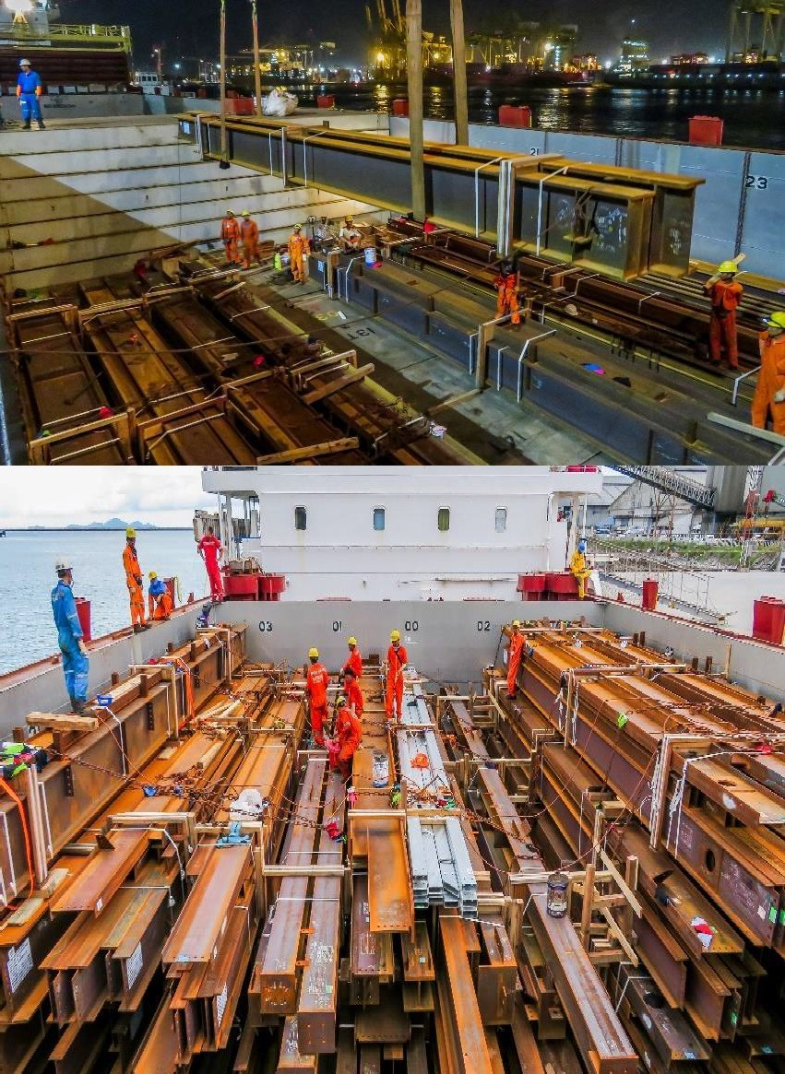
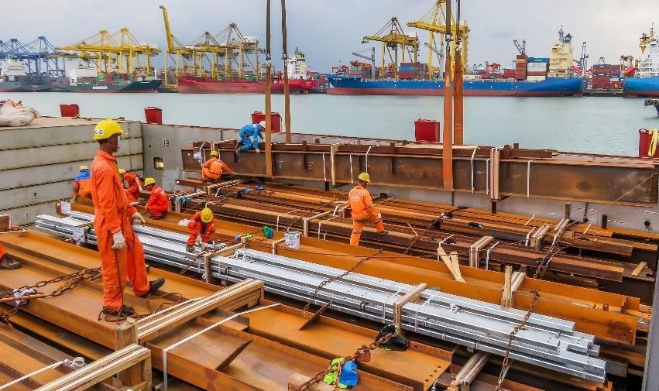
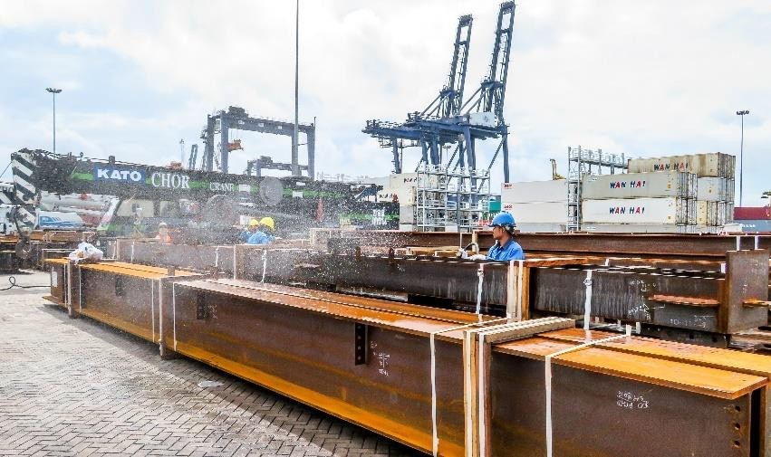
PROJECT REFERENCES
CASE STUDY – BURLINGAME POINT
Project Name: Volume: Commodity: Origin: Destination:
Burlingame Point Project 5,000 cbm, Max. GW 20 MT
Steel beams
Thailand Stockton, USA
Scope:
Pre-Carriage EXW to Laem Chabang port
Re-loading and FAS delivery at Laem Chabang port
Loading and securing onto break bulk vessel
Break bulk ocean freight from Laem Chabang port to port of Stockton
On-carriage to site

