Slide 1
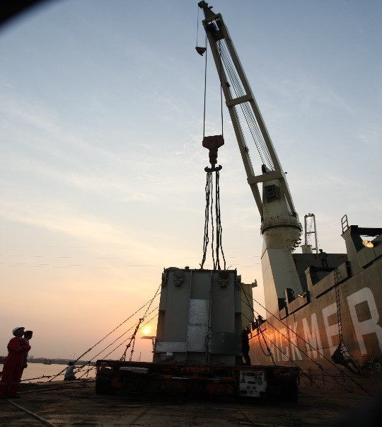
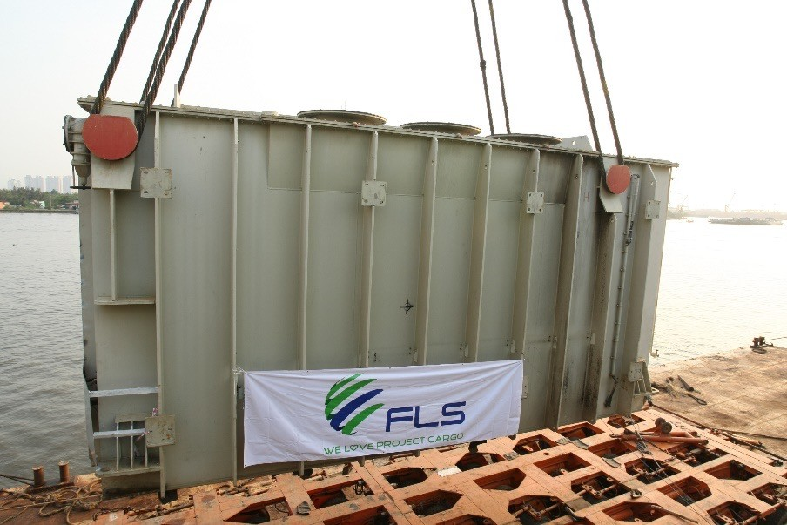
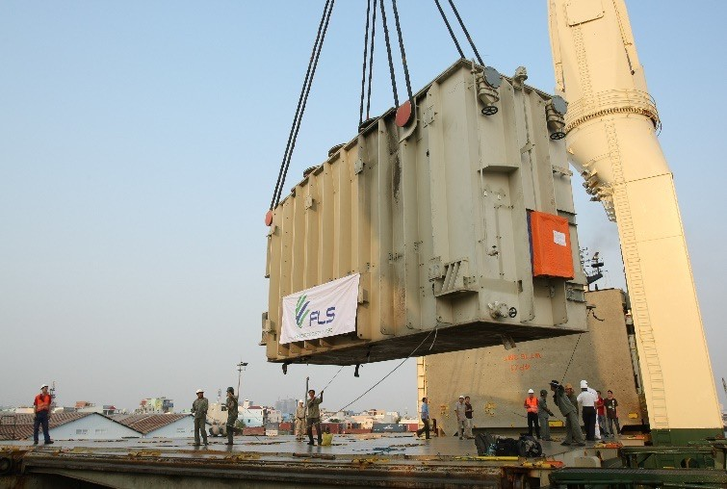
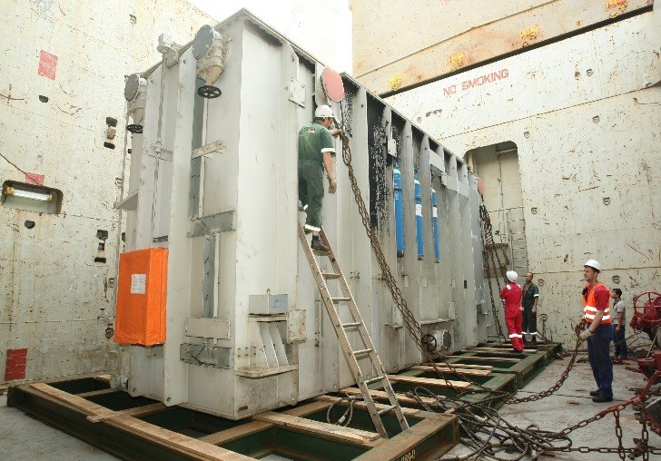
PROJECT REFERENCES
CASE STUDY – 202 tons transformer from Ho Chi Minh City to Qingdao
Client: Consignee: Commodity: Origin (POL):
Destination (POD):
Scope:
Phy My 3 BOT Power CO. LTD Siemens China
202tons Transformer – 950x320x465cm
Phu My / HCMC Qingdao
Order from Phu My 3 BOT Co. Ltd to transport a broken transformer from Phu My site foundation to Quingdao port for a repairing job at Siemens China workshop.
FLS arranged pre-carriage ex site foundation and barging alongside ocean vessel.
As well as part chartered a heavy lift vessel shipping the 202MT Trafo from HCMC port to Quingdao port
Return transport including vessel chartering back to Vietnam had been arranged by FLS as well.

