Slide 1
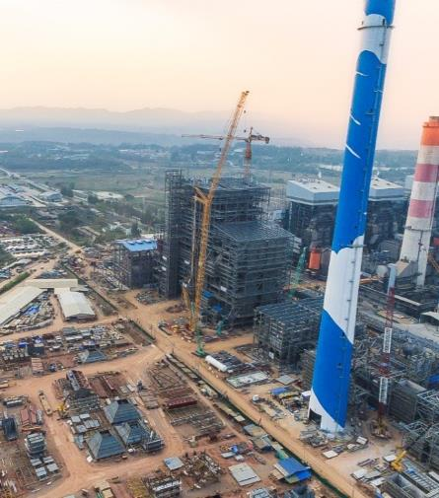
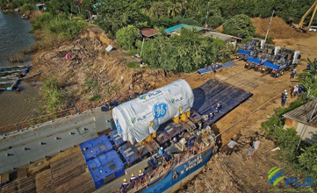
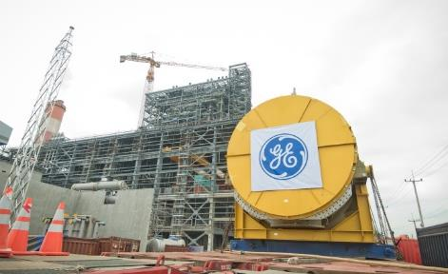
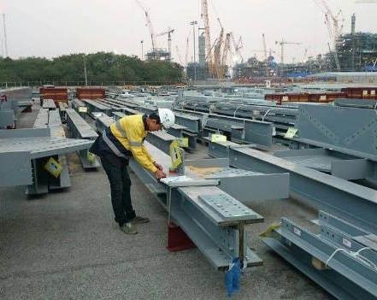
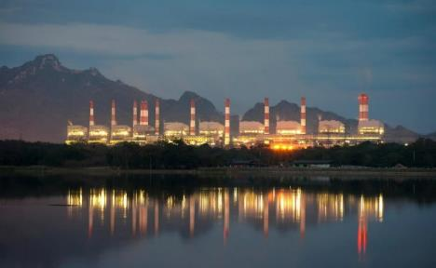
PROJECT REFERENCES
CASE STUDY – MAE MOH POWER PLANT PROJECT
Project Name: Mae Moh Unit 4-7 Replacement Project
Client: GE Power Switzerland, USA, China and India
Black & Veatch, USA
Balanced Engineering & Construction,
Volume: Appr. 135,000 Rton break bulk, 25,000 Rtons
Commodity: Steel structure for boiler house, turbines,
generators (including one 360 metric tons), tanks, environmental control, units,
Origin: Worldwide
Destination: Mae Moh, appr. 600 km north of Bangkok (around 444km north of Nakhon Sawan)
Scope:
feed water system.
Import port handling in Laem Chabang, customs clearance
Thai Flag Waiver, road transport to construction site, barging, site co-ordination
Ocean freight for specific parts of the project
Warehousing and storage, re-packing, repair, de-and re-consolidation
Survey and consultation work
Co-ordination with suppliers worldwide

