Slide 1
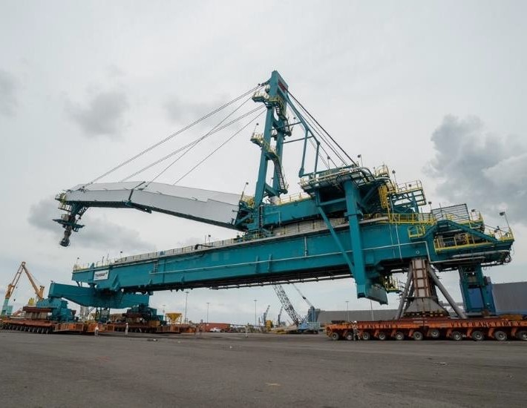
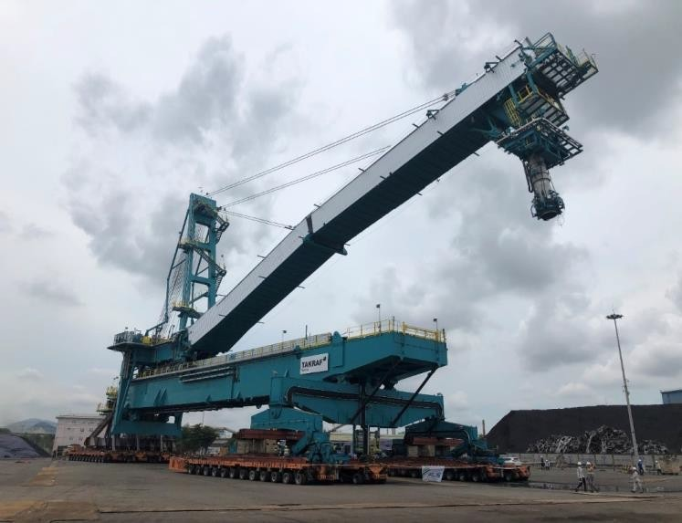
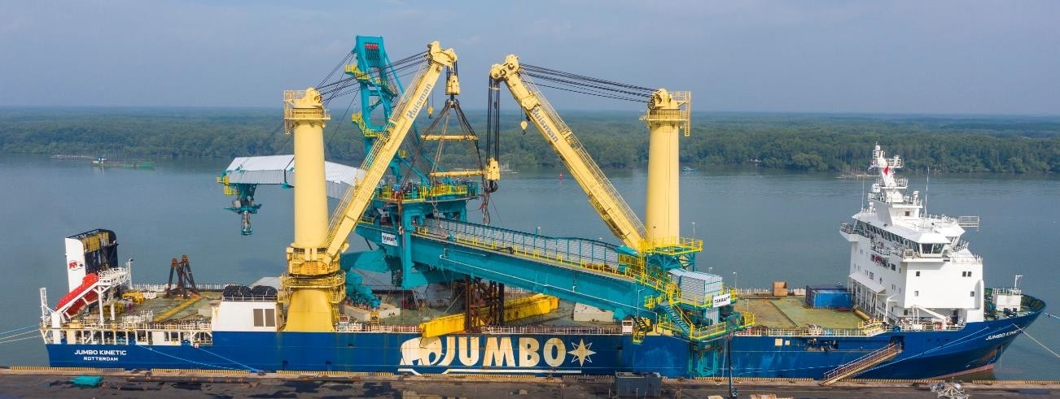
PROJECT REFERENCES
CASE STUDY – 1500 TON BULK SHIPLOADER
Dimensions: Commodity: Origin: Destination:
135 x 25 x 43 m – 1,500 MT
Radial Quadrant
Shiploader Phu My, Vietnam
Vancouver, Canada
Ground preparation (foundation)
Leveling of transport route
Removal of light towers, fire equipment, concrete divider
Shifting via 96 SPMT axles
Setup + movements were shaped to match the schedule of the vessel, construction team + port operator
Supervision by multiple FLS professionals
Scope:

