Slide 1
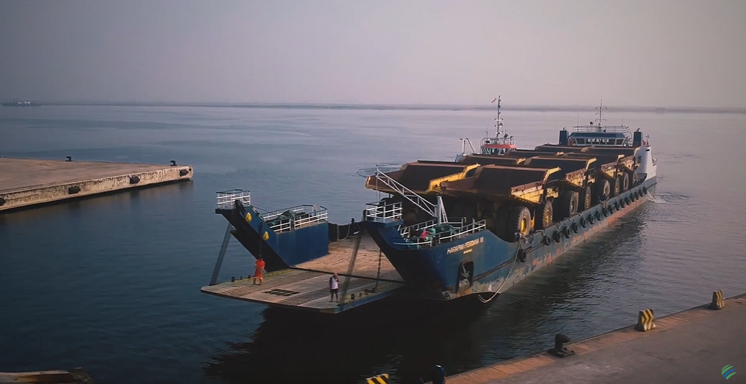
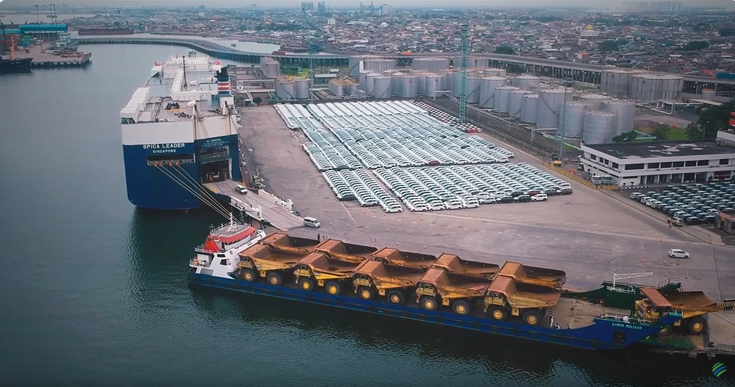
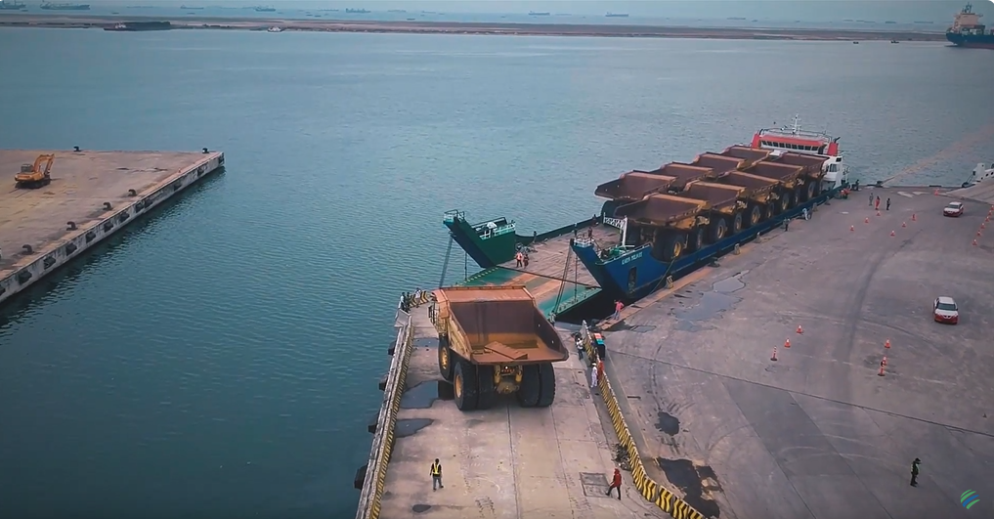
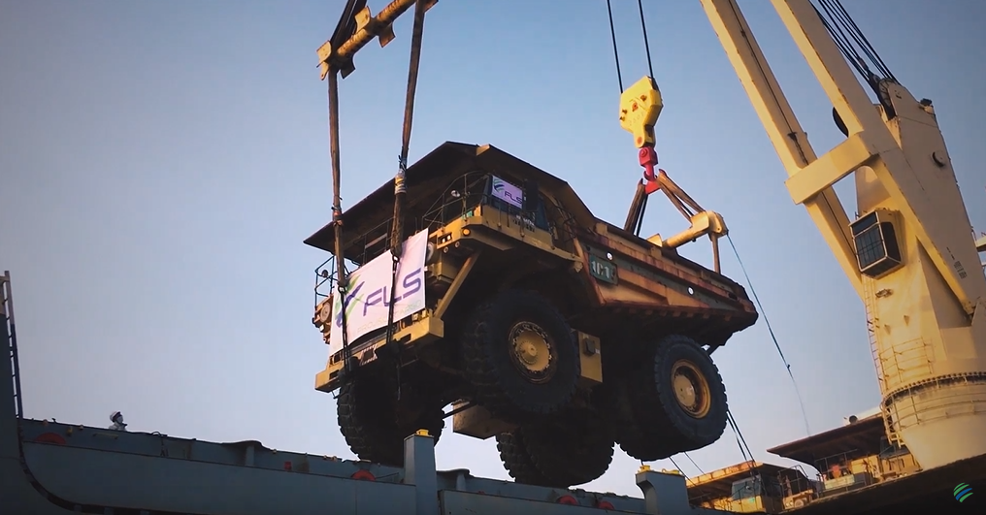
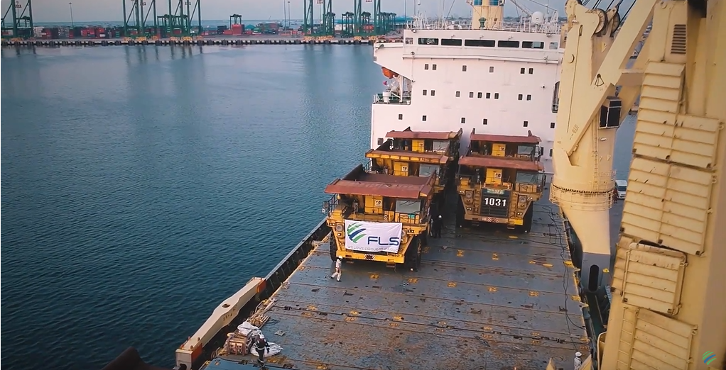
PROJECT REFERENCES
CASE STUDY – Mining Dump Truck HD 1500-5 Series
Project Name: Mining Dump Truck HD 1500-5 Series
Cargo: 31 x Mining Dump Truck HD 1500-5 Series
POL: Tanjung Priok International Port of Jakarta
POD: Xingang International Port of China
Scope:
Vessel chartering services
Port and terminal handling services
Export customs clearances services
Stevedoring loading at Port of Shipment
Lashing, securing, and discharging all cargo material inside sea carrier
Sea freight from Port of Shipment up to Port of Discharging
Arrival at Port of Discharging under CFR terms

