Slide 1
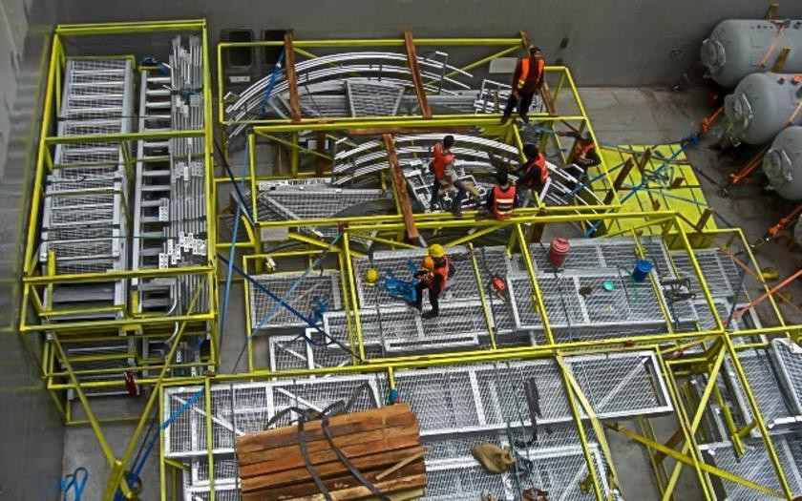
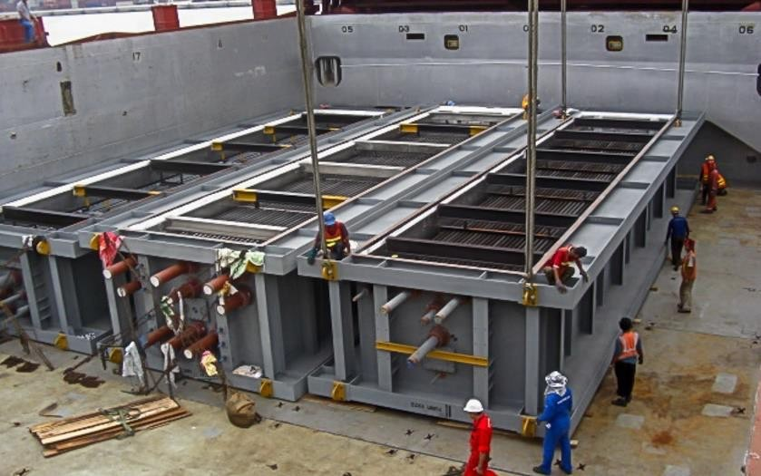
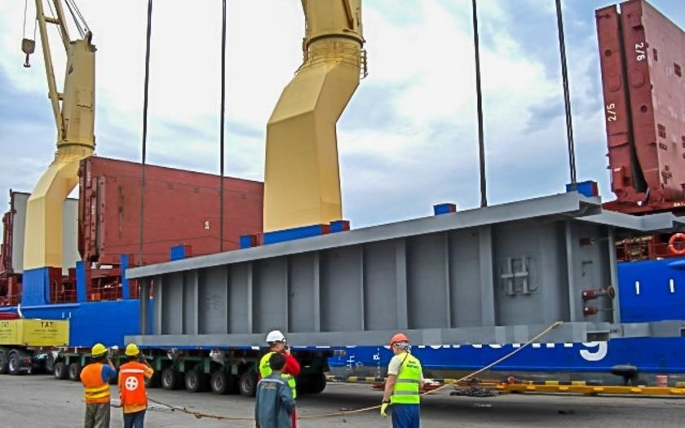
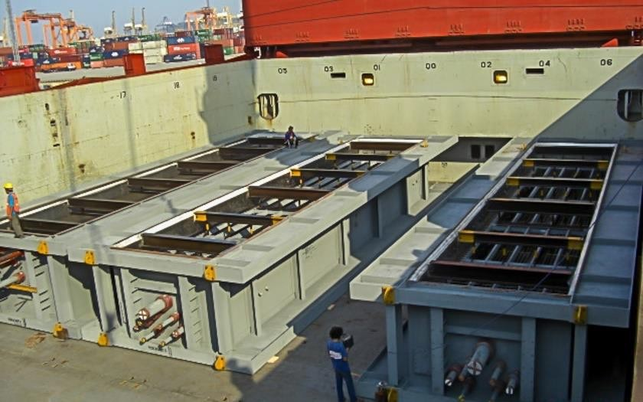
PROJECT REFERENCES
CASE STUDY – LOS ESTEROS
Project Name: Project Owner: Volume: Commodity: Origin: Destination:
Los Esteros Project VPI
7,000 cbm, Max. GW 150 MT
Steel beams, modules Thailand
Stockton, USA
Scope:
Loading and FAS delivery at Laem Chabang port
Loading and securing onto break bulk vessel
Break bulk ocean freight from Laem Chabang port to port of Stockton

