Slide 1
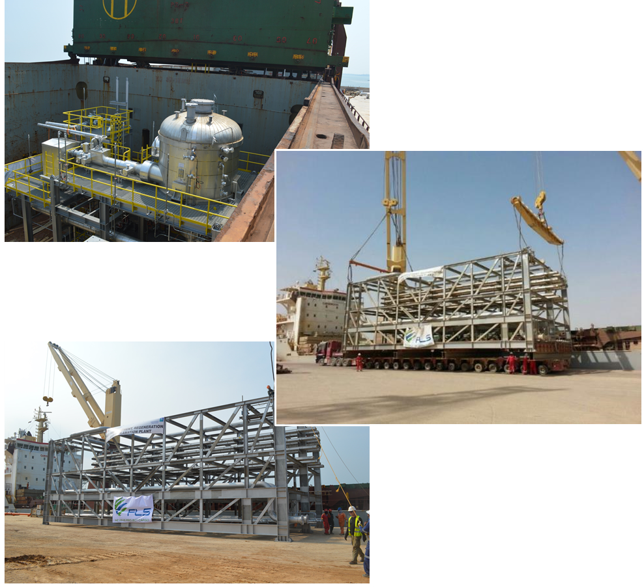
PROJECT REFERENCES
CASE STUDY – WASIT GAS REFINERY
Project Name: Wasit Gas Refinery
Client: VME Process Pte. Ltd.
Volume: Approximately 90,000 Frtons
Commodity: Pipe-racks, skids, spools
Origin: Batam, Indonesia
Destination: Wasit Project Site, Saudi Arabia
Project duration: 2015
Scope:
Loading at fabrication site in Batam, ocean freight to KSA, customs clearance and storage and haulage to project site
5 full and part charter break bulk ocean vessels, of approximately 90,000 frtons of modules, from Batam to Jubail Industrial Port, KSA
100 container loads of loose items from Batam to Dammam Port
Haulage of cargo from Jubail Industrial Port and Dammam Port to site (approximately 80 km & 120km respectively)

