Slide 1
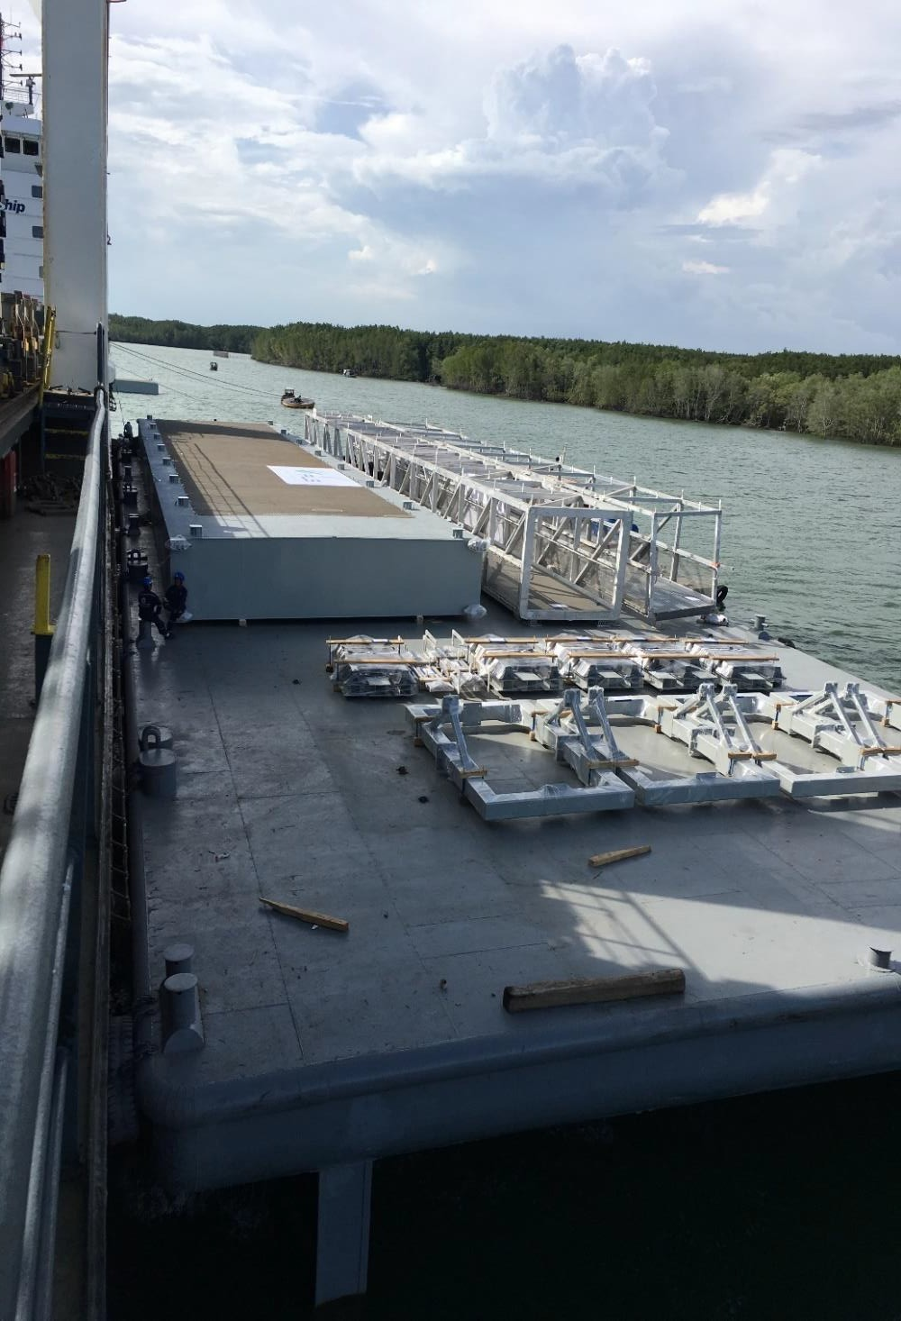
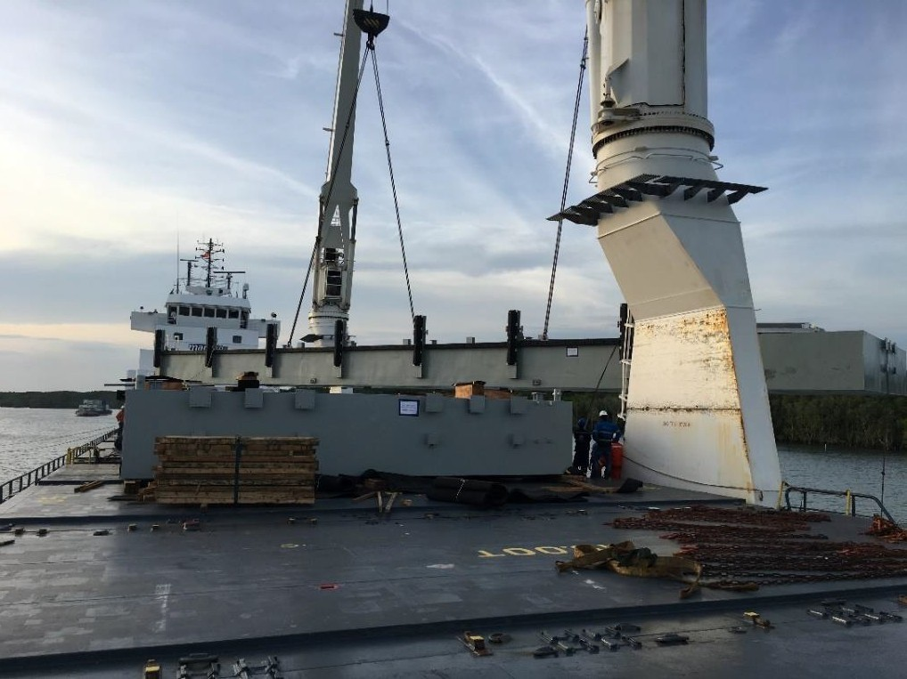
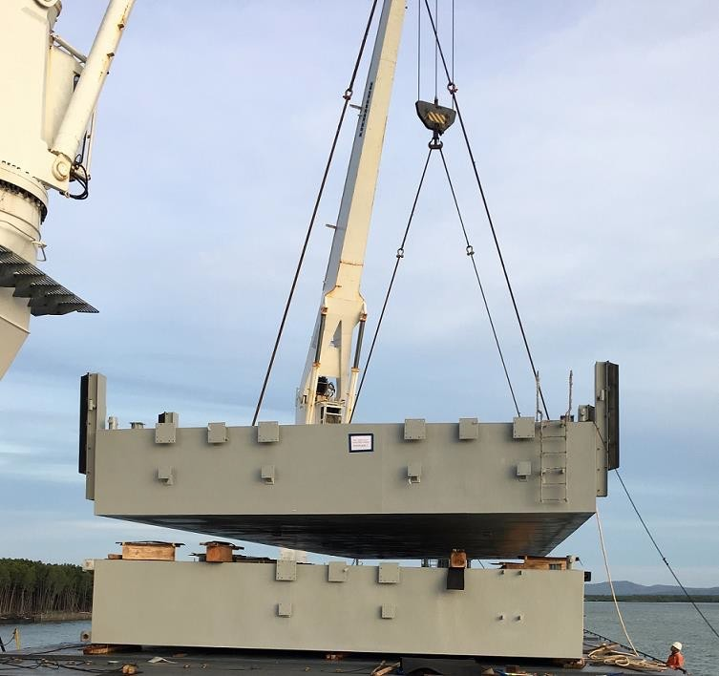
PROJECT REFERENCES
CASE STUDY – 2 X PONTOON’S TO AUSTRALIA
Volume: Commodity: Origin: Destination:
Scope:
3,250 FRT; Heaviest Lift 100 MT Floating pontoons
Vietnam
Australia
Door to Door transport Incl. barging and towing both ends
Customs clearance + quarantine management allowed for direct discharge to Australian waters
FLS In-house stevedores and engineering department, developed a suitable solution, to stack the pontoons, which reduced the shipping cost significantly

