Slide 1
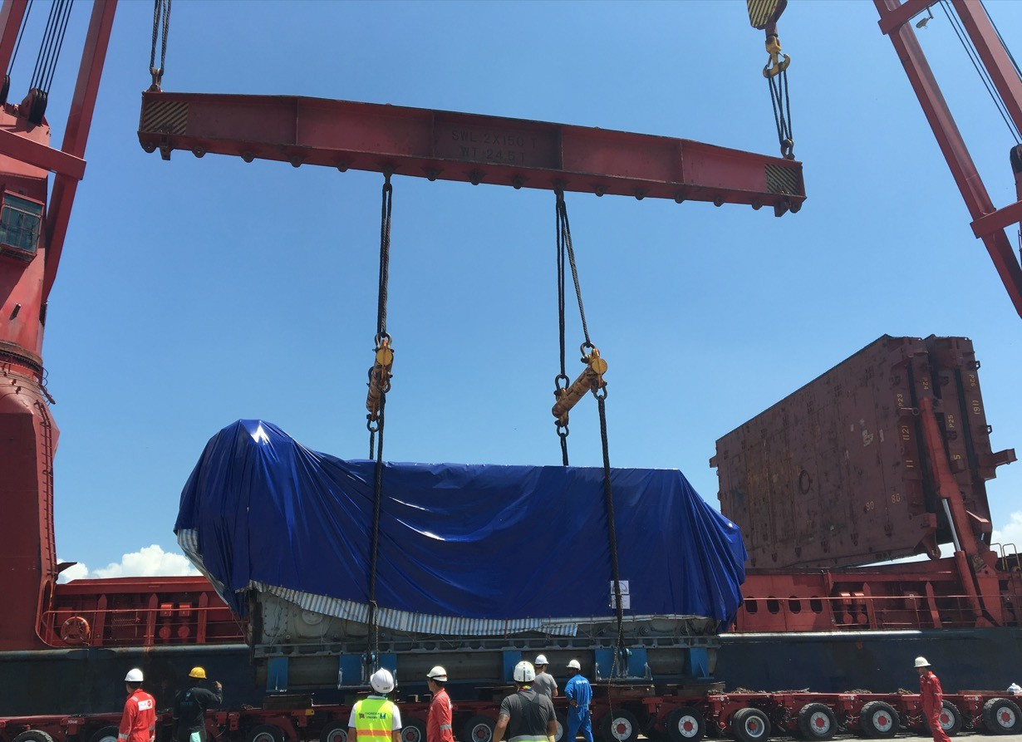
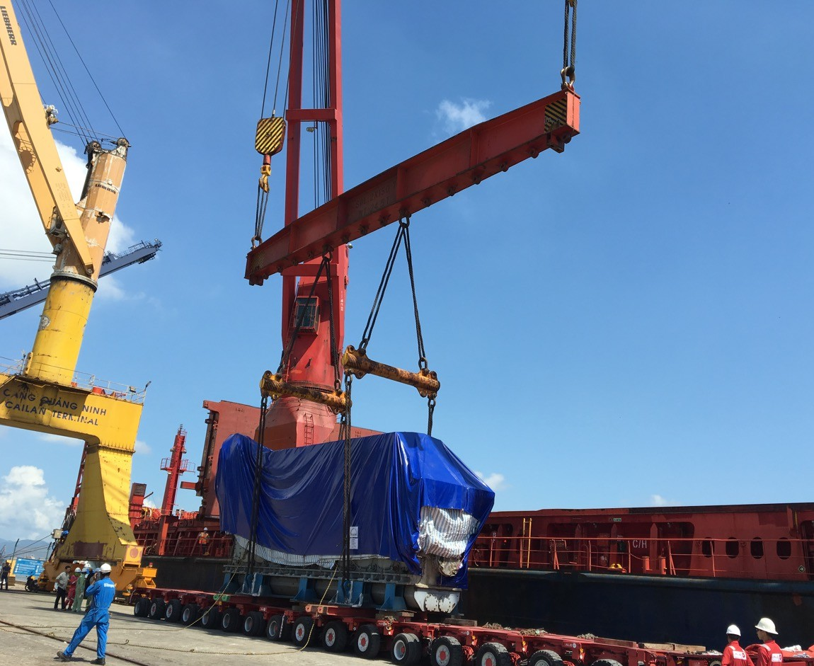
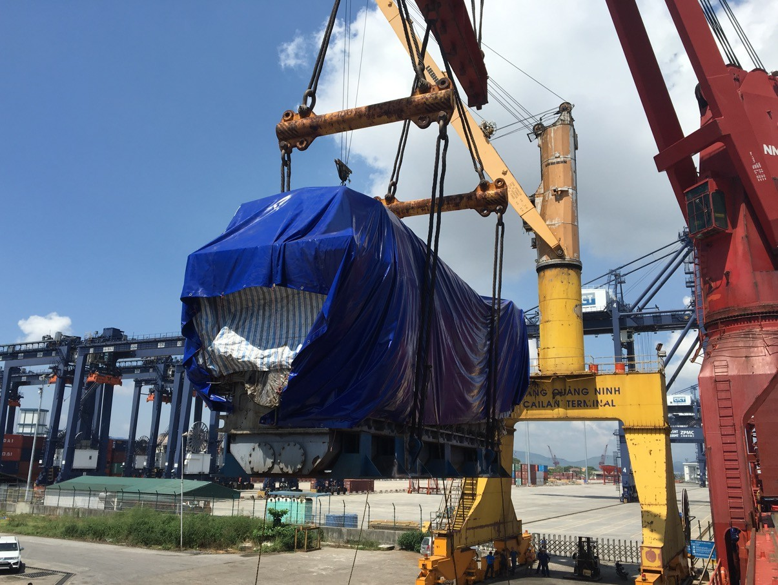
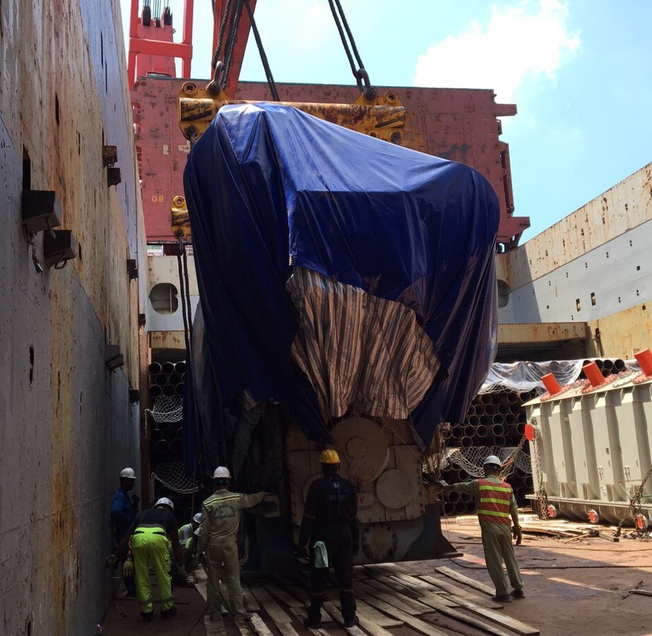
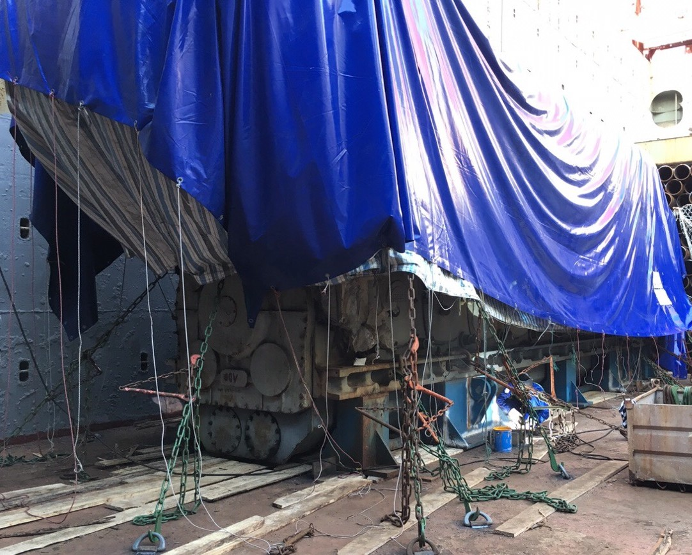
PROJECT REFERENCES
CASE STUDY – 234.5MT DIESEL ENGINE PROJECT
Volume: Origin: Destination:
Scope:
1x 13.05x3.65x5.50M , 234.5 T
Cai Lan port, Vietnam Hamburg, Germany
Chartering Heavy lift vessel based on Liner Terms hook/hook
Preparing technical design for stow plan, lifting plan and secure cargo in accordance to the LASHCON IMO Standard.
Loading onto vessel incl appropriate cargo stow arrangements. Cargo hold preparation for loading, layout dunnage by FLS own stevedores
Loading supervision by FLS Port Captain

